Slide 1
The Cycle of Trust Insights for implementation of HIT in the VHA
Ginnifer Mastarone, Ph.D.

Slide 2
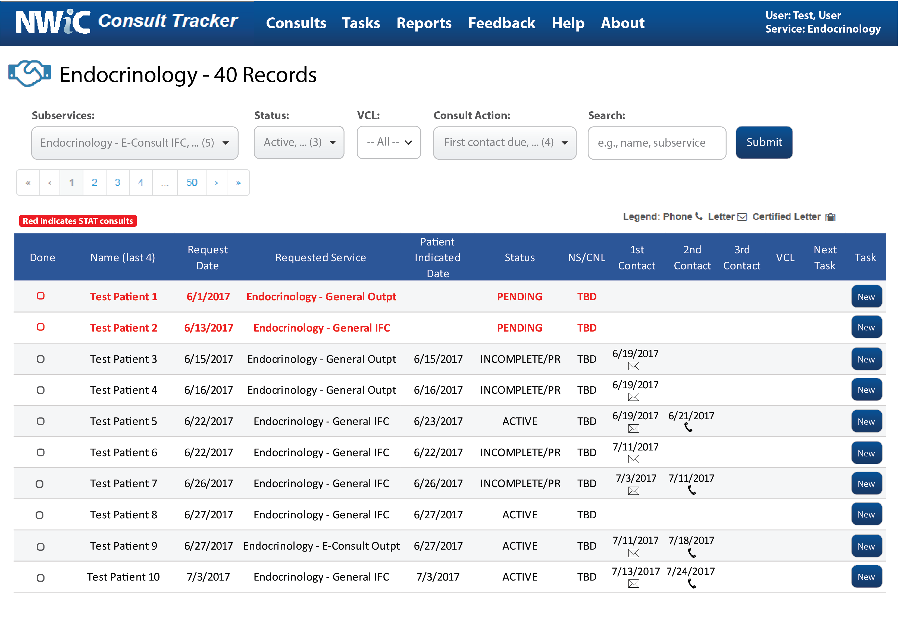
QI Initiative: The Consult Tracker
In 2017, medical schedulers received approximately 33,456 consults at our facility each month
CT retrieves, sorts, and displays all consult requests, organized by specialty
CT also displays the number of appointment scheduling attempts with dates to align with facility policies
Currently, 17 medical services in our facility use the CT (e.g. cardiology, urology, dermatology, rheumatology, endocrinology)

Slide 4
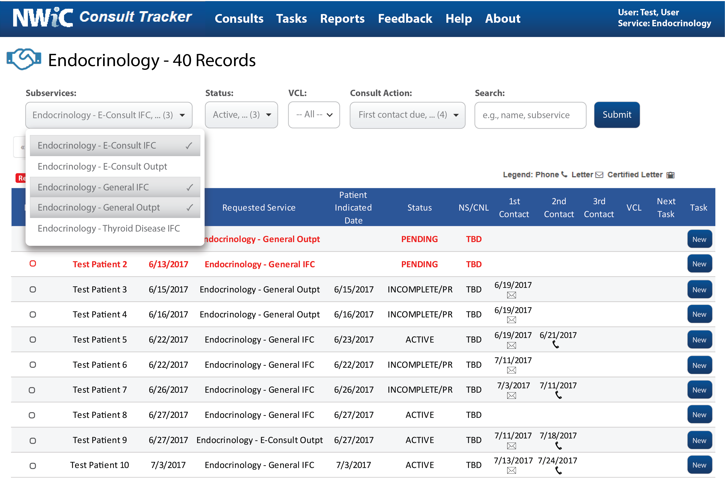

Slide 5
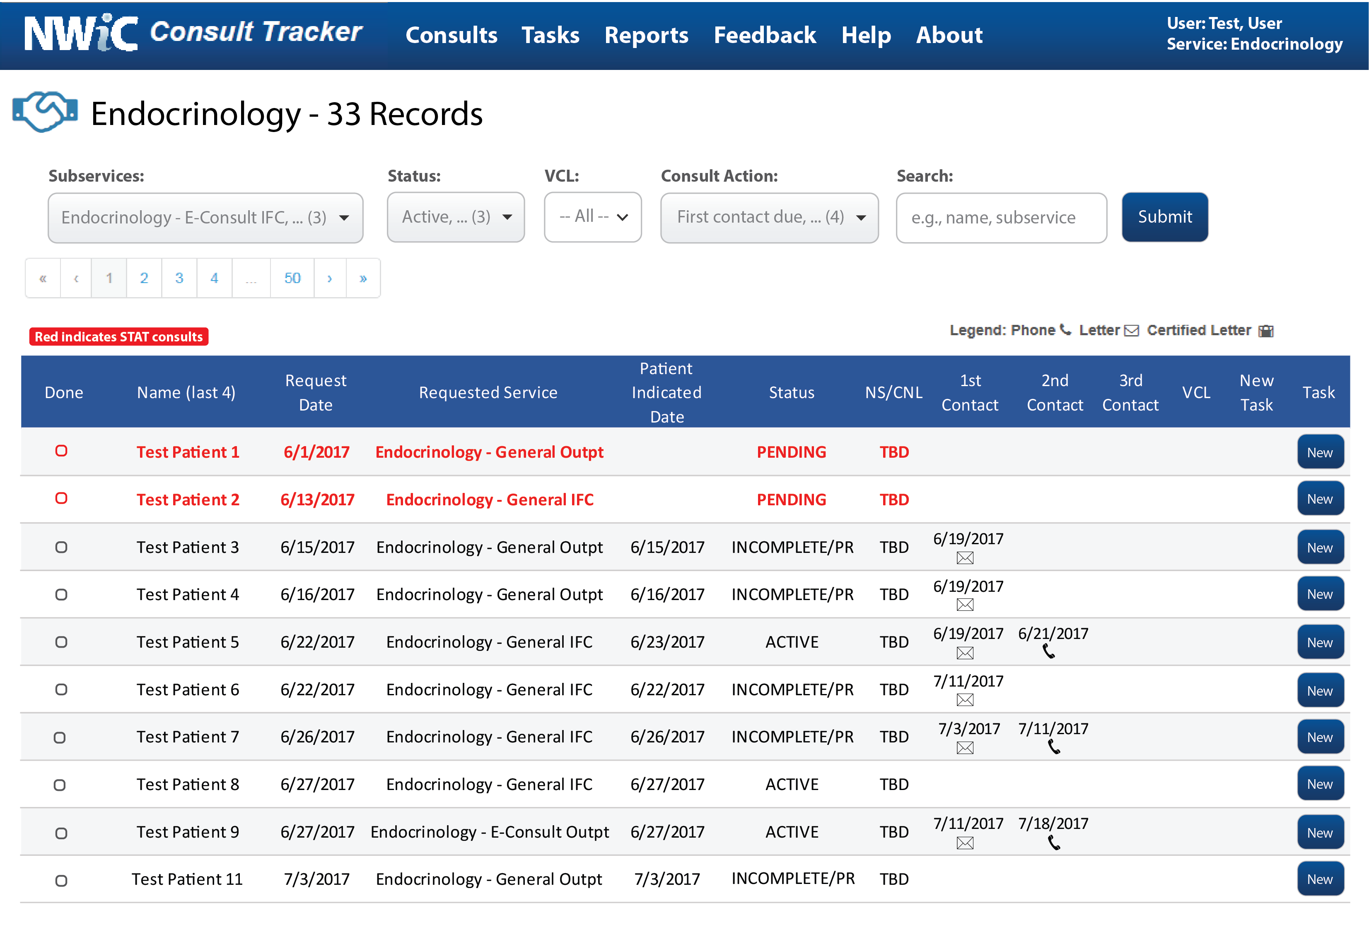

Slide 6
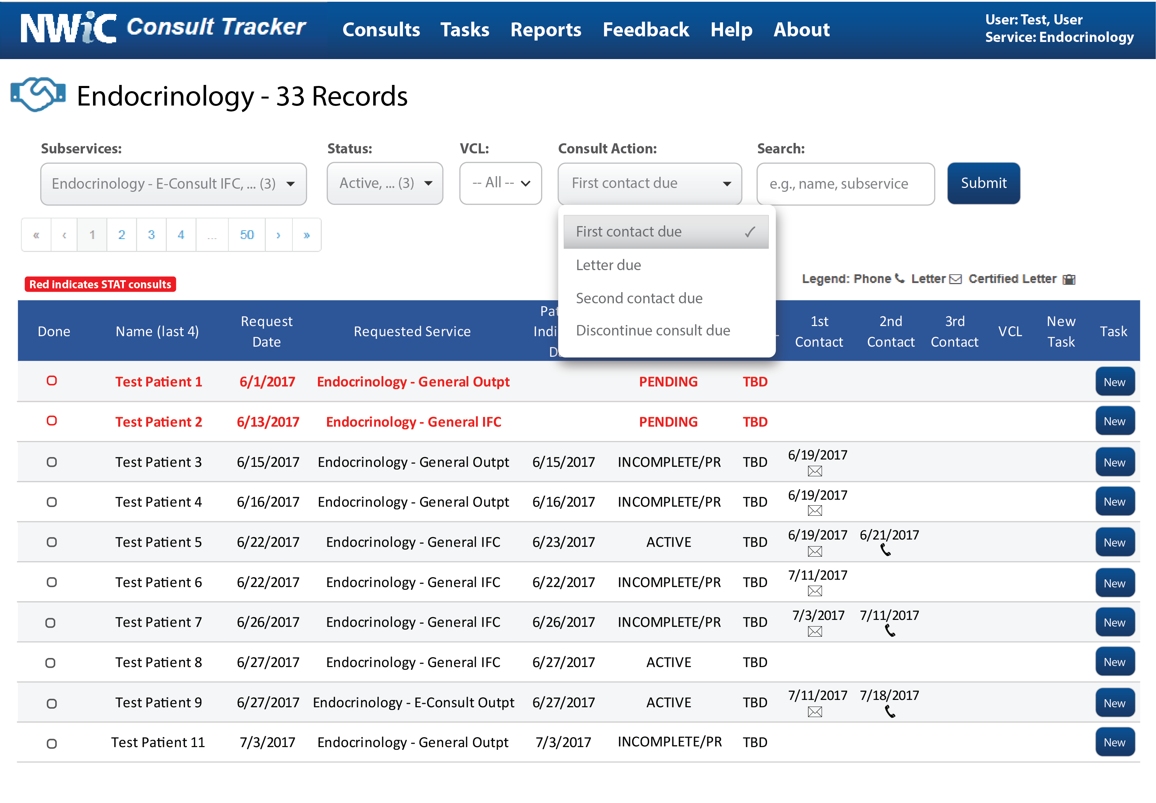

Slide 7
Agile Development
1:Requirements
2:Plan
3:Design
4:Develop
5:Release
6:Track and Monitor

Slide 8
Observation: Mixed Acceptance of CT
Staff used the software in unexpected ways
They continued to rely upon individually developed processes
These paper process were possibly error-prone
Medical Schedulers double-checked their CT work with more established legacy technologies.
WHY?
We didn’t know
Our observations did not align with feedback from stakeholders
Working hypotheses included: inadequate training, they didn’t want to (resistance), they didn’t need to use it, and… maybe they didn’t trust the new application.

Slide 9
Trust Definition
We define trust as the end user’s willingness to:
rely upon a technology to complete assigned tasks
take actions based upon the information output
This definition builds upon prior investigations outside of the healthcare arena that conceptualized trust as a cognitive process influenced by perceived risk (McKnight et al., 2002; Mayer, Davis & Schoorman, 1995; Jarvenpaa, Tractinsky, & Saarinen, 1999).

Slide 10
Trust and HIT Adoption
HIT adoption is dependent on:
attributes of the user, the environment, and the innovation
Prior research suggest that trust in HIT content and performance is a strong predictor of adoption and use
Most of these studies examine trust as an additional component of technology adoptions models. But,
They do not identify the attributes or criteria of a trustworthy technology
There is no definitive measurement of trust in healthcare settings
Prior metrics focus on the trust that patients have in ehealth technologies as they interact with their physicians or engage in health management

Slide 11
Objective: Approach HIT Trust Measure
1
Determine what aspects or attributes of the CT made it “trustworthy” for end users.
2
Identify implementation-based barriers or facilitators to the perceived “trustworthiness” of the CT during the product development life cycle.

Slide 12
Protocol
Develop Interview Script
Pilot Interview Script
Cognitive Interviewing
Field Test Interview Script
Training/Feedback
Ensure reliability
Address possible limitation
Data Analysis: Rapid Assessment Process
Collect Data

Slide 13
Script
Participants were asked to answer questions in relation to the workplace
What do you expect from a technology that you trust?
What helps build trust in a new application so that they would use it?
Did training influence your trust in the CT? Why or why not? (UTAUT – facilitating conditions)
Does leadership support increase your trust? Why or why not? (UTAUT – social influence)
Probe: supervisors; hospital leadership
Demographics
Age category (digital literacy)
Gender
Highest level of education (determinant of familiarity with technology)

Slide 14

Sample
19 out of 23 medical schedulers participated
8 medical specialty services
Cardiology, Endocrinology, Gastroenterology, Geriatrics, Hematology/oncology, Hospital medicine, Pulmonary, Rheumatology
Age
6 aged 20-36 (Millennial)
9 aged 37-52 (Generation X)
4 aged 53-71 (Baby Boomer)
Education
8 completed high school
7 Associates or Bachelors degree
2 Master’s Degree
Medical Schedulers

Slide 15
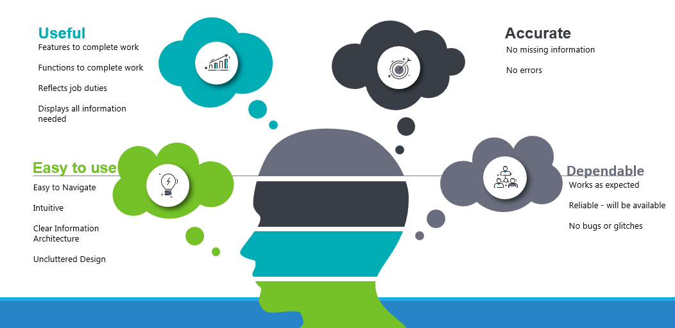

Slide 16
In their own words: Useful
Reflects Workplace environment and work processes:
“I am talking on the phone with the patient and have to be fast.”
[has] “all of the information to do the job”
“workload becomes more efficient and faster”
Medical Schedulers

Slide 17
In their own words: Easy to use
“a technology that I trust is one that helps me do my job with little complexity”.
“some applications are three screens, are too busy, and hard to understand”
One user turned to another application to express frustration with hard to navigate interfaces
“I want to find features. Are they there? Can I find them?”
Medical Schedulers

Slide 18
In their own words: Accurate
“I trust it when there is no missing information or included errors”
Users were concerned with risk (e.g. making mistakes)
“the stakes are high when patients might slip through the cracks”.
“Most of mine [consults] have been up on the CT correctly. But if I see an order that doesn’t sound right, I go to the doctor.”
Medical Schedulers

Slide 19
In their own words: Dependable
“I expect the CT to work everyday”
“I expect it to work the first time I get it. I’d be upset if there were multiple glitches in the program.”
Another participant stated that trust in the CT was built when “all features appearing in the tool can be utilized”.
Medical Schedulers

Slide 20
Trust Barriers and Facilitators

Slide 21
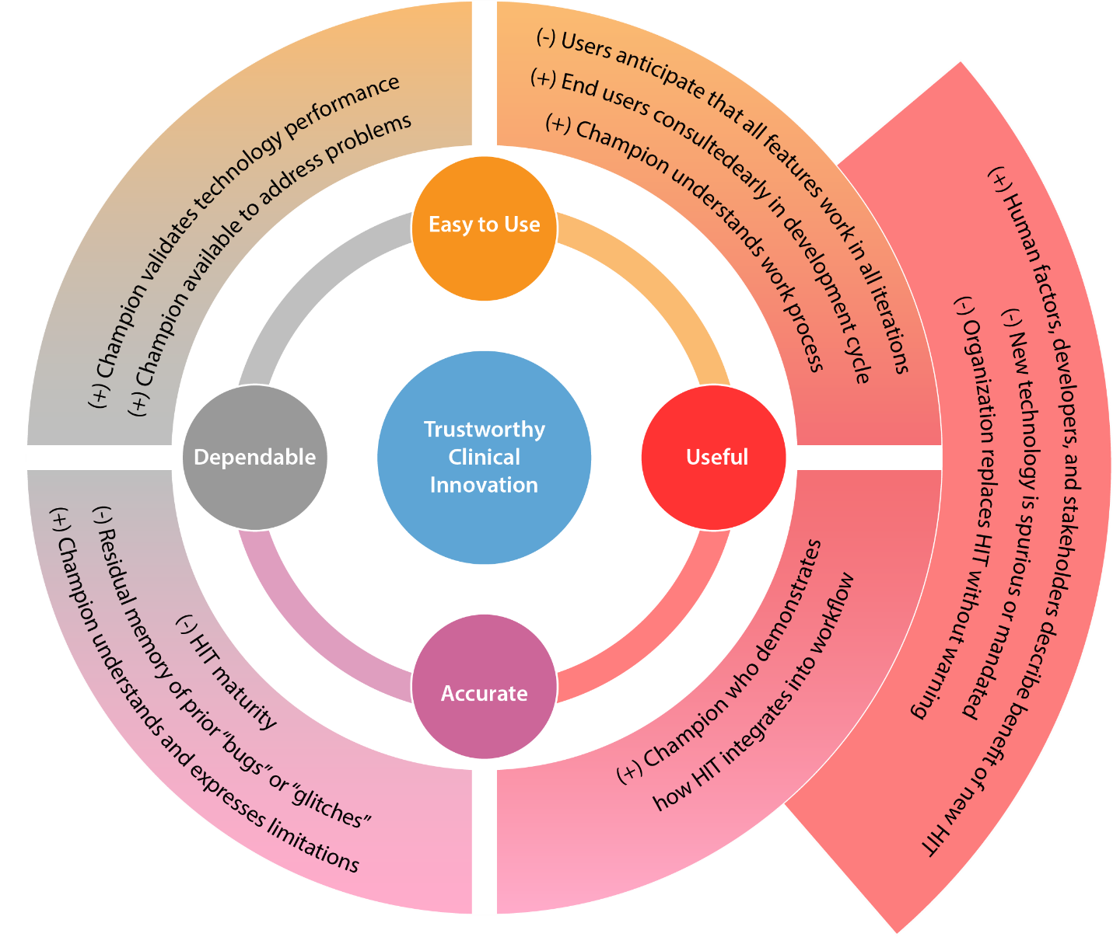

Slide 22
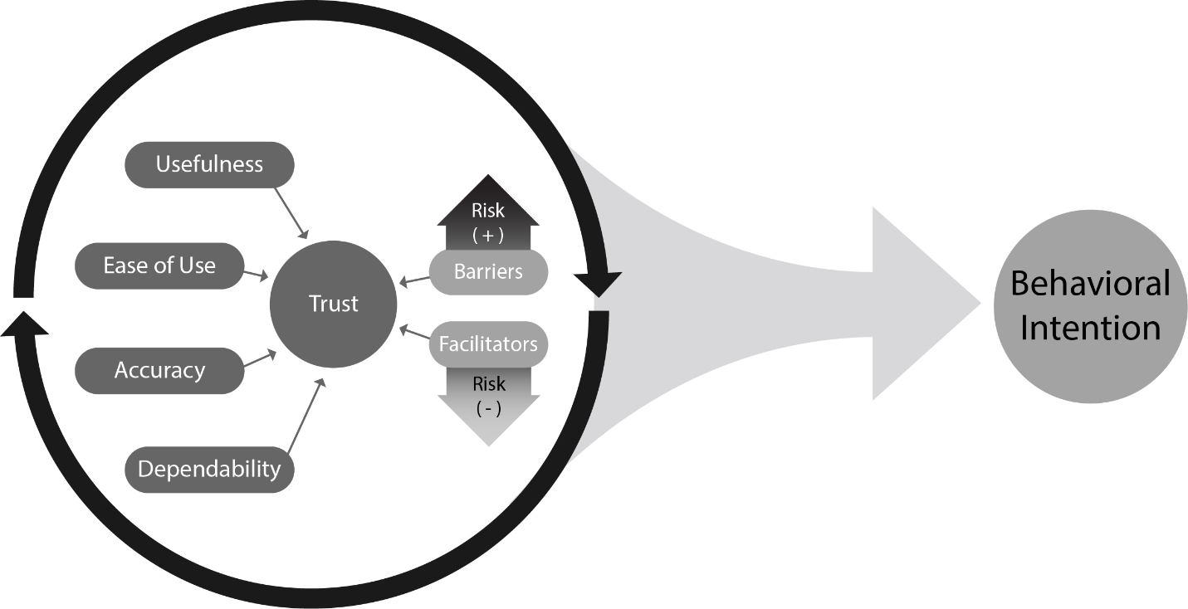
Discussion
Notable finding: Trust operates in a feedback loop
Notable finding: Accuracy and Dependability trust criteria

Slide 23
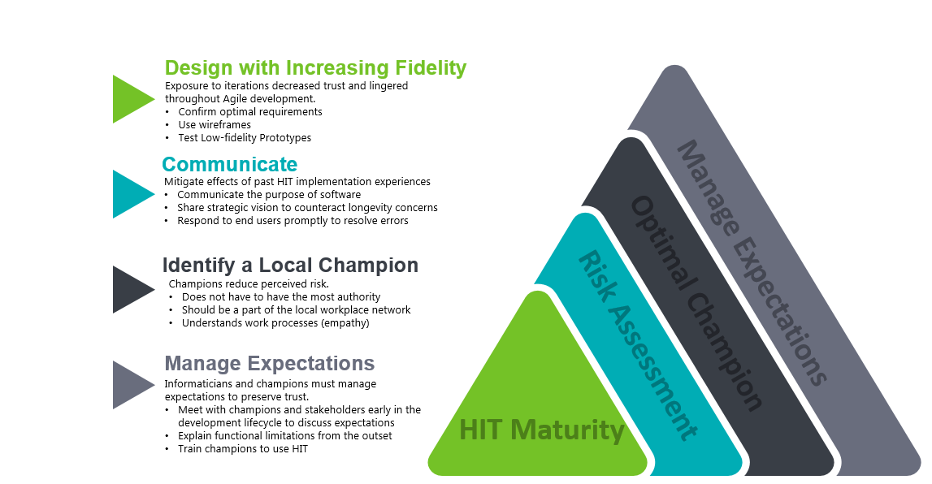

Slide 24
Co-author Acknowledgement
Jack Wiedrick, MS
Abigail Huang, MD
Alan R. Teo, MD
Anthony Sayers, MS
Stephanie Tallett, BA
Kathleen Adams, MPH
Jennifer L. Barton, MD
Kathleen F. Carlson, PhD
Jianji Yang, PhD
Travis Lovejoy, PhD
Victoria Church, BSN, CNS
Blake Lesselroth, MD, MBI, UXC, FACP

